Slide 1
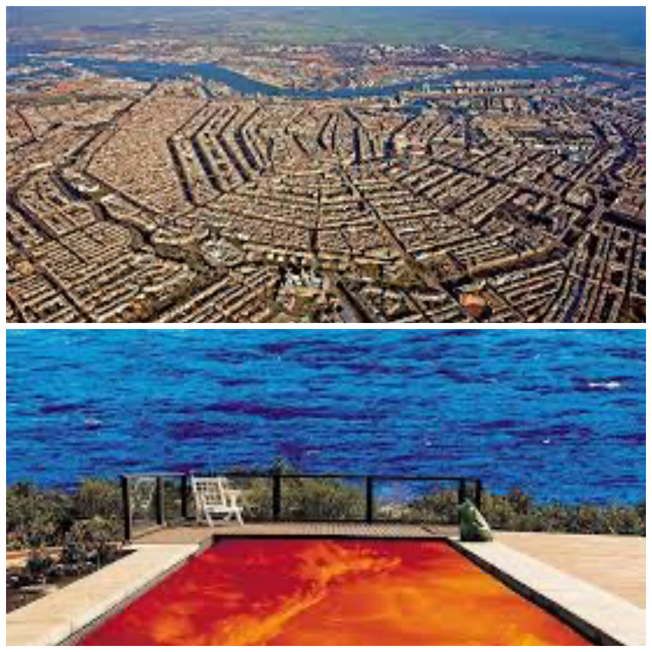
Unlearning the LA school’s model: The Randstad as a Mutation of Californian Postmodernity
Frank Xu
Amsterdam University College
AMS Conference, 23 Apr

Slide 2

Question: If you can improve one thing in the Randstad, what would you choose?

Slide 3
The LA model

Slide 4
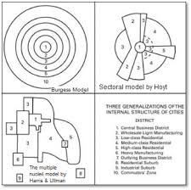

Slide 5
Traditional concepts of urban form imagine the city organized around a central core in a revised theory, the urban peripheries are organizing what remains of the center.
A global, corporate-dominated connectivity is balancing, even offset- ting, individual-centered agency in urban processes.
A linear evolutionist urban paradigm has been usurped by a non-linear, chaotic process that includes pathological forms such as transnational criminal organizations, common-interest developments (CIDs), and life-threatening environmental degradation (e.g., global warming).
represents a space-time-society geographical prism that acutely reflect the contemporary urban dynamics

Slide 6
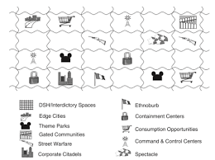

Slide 7
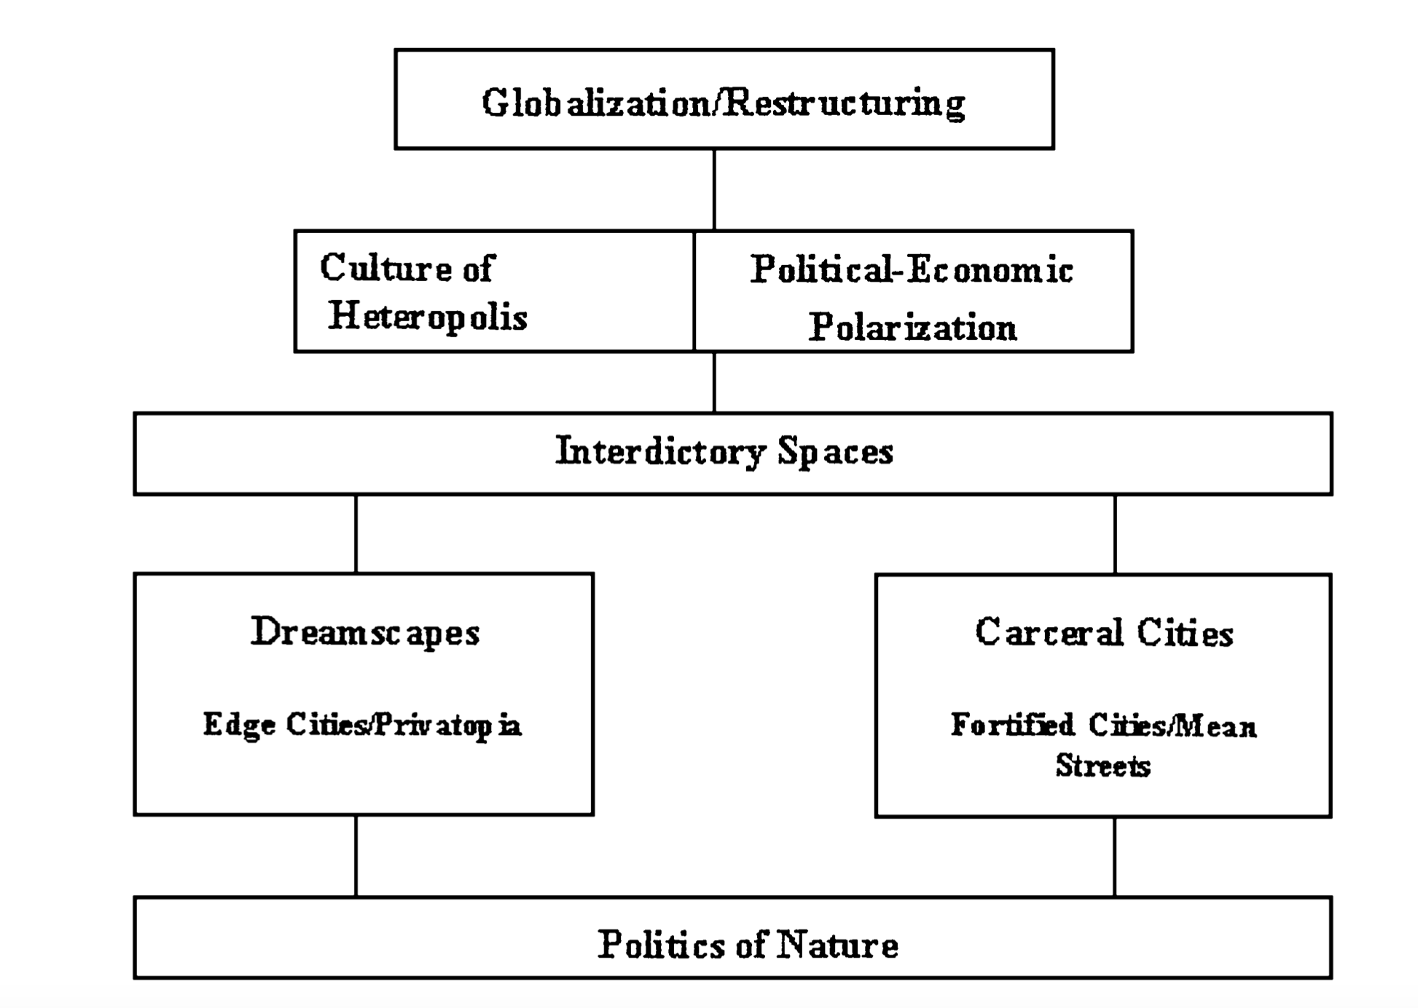

Slide 8
Why
Randstad

Slide 9
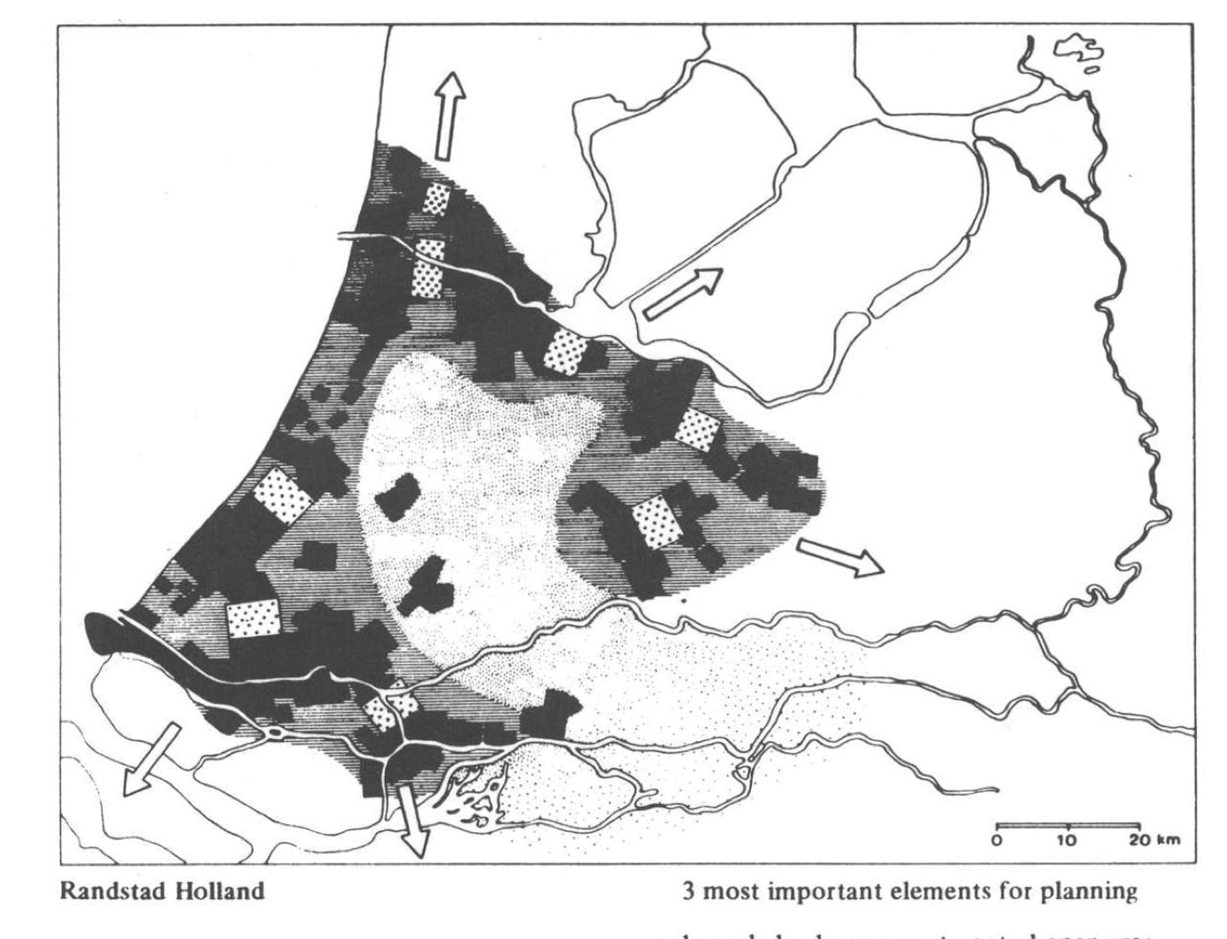
Fitting Randstad into the Model
Rand means rim in Dutch
Planning doctrine: polynuclear metropolis with peripheral development
Puntstad
Buffer zones
Green Heart

Slide 10
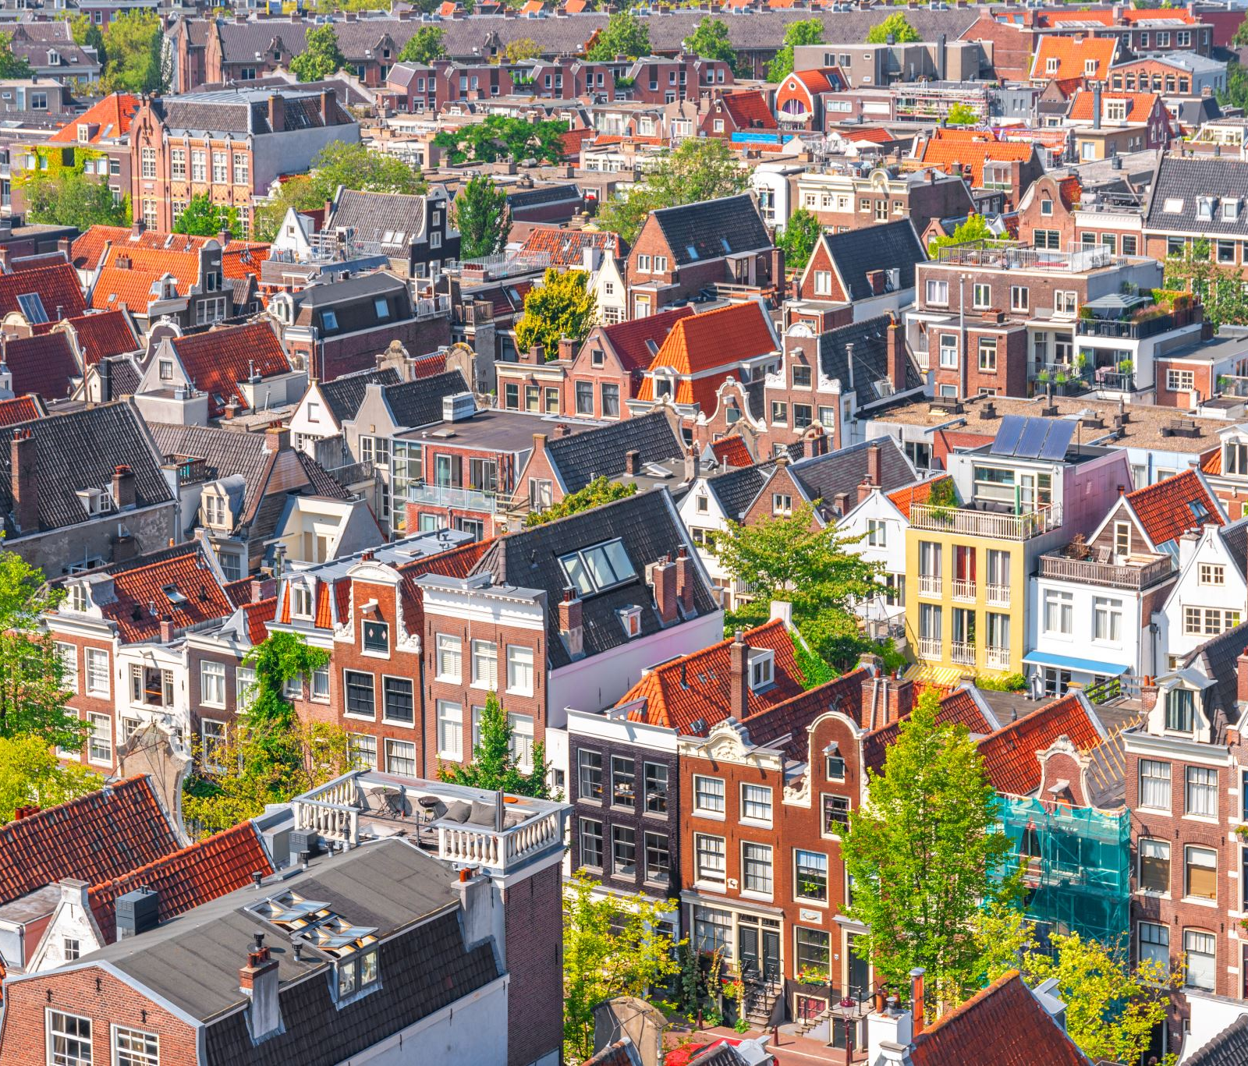
LA School‘s Reaction on Randstad
Edward Soja pointed out the similarity of the Randstad and LA in terms of sprawl
Soja was inspired by Rem Koolhaas
Quote from Koolhaas: I have had the feeling that the major Dutch cities (with Amsterdam in the lead) deny out of sentimental considerations the fact that they are part of a larger whole (an area as large and diffuse as Los Angeles) and as such completely ignore a dimension of an entirely different order from the one which they traditionally know.’ (Rem Koolhaas, in Amsterdam: An Architectural Lesson, 1988: 112)

Slide 11
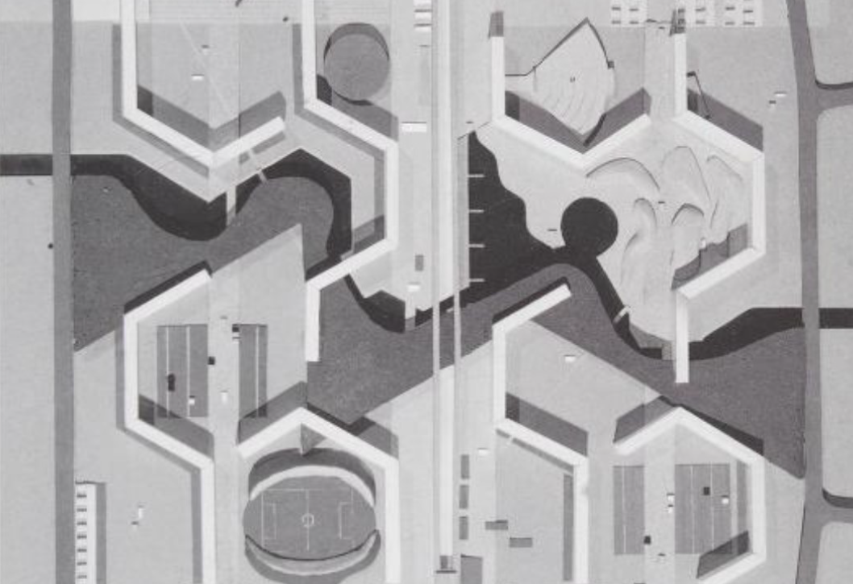
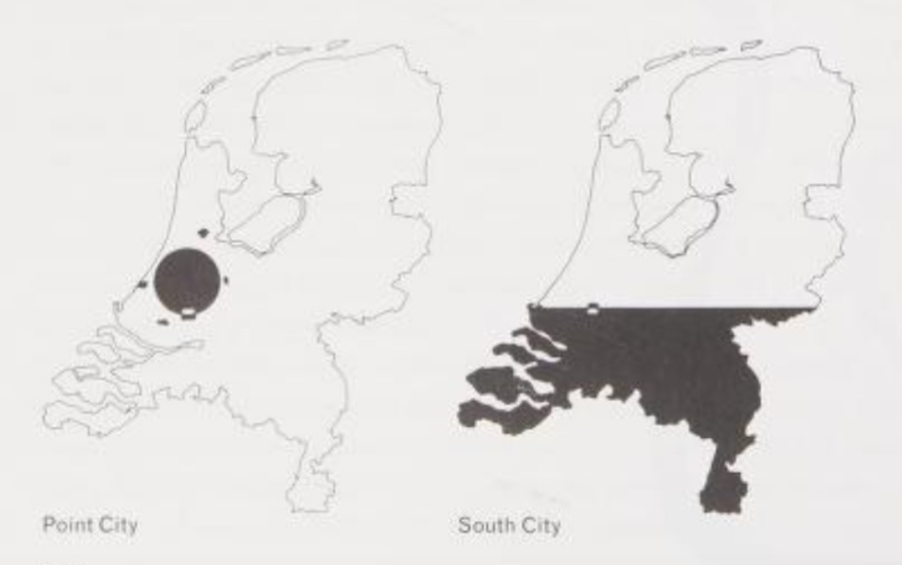
Koolhaas as a lens to see the compatibility and anomalies: exopolis/heteropolis (Bijlmer), alternative model to the Puntstads: South Cities (a global perspective)/Comparative advantage paradigm (Lambregts)

Slide 12
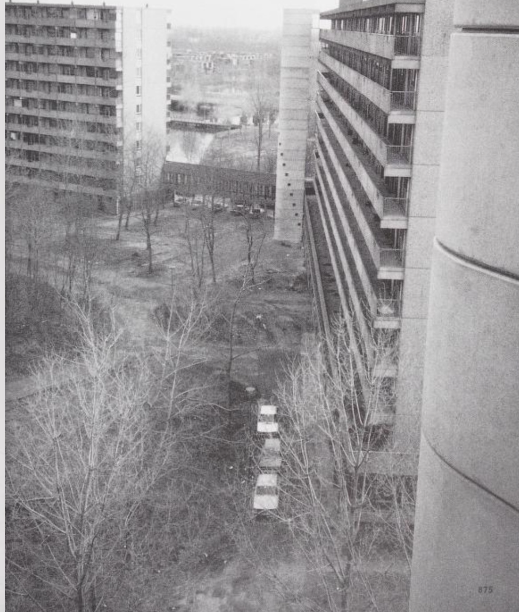
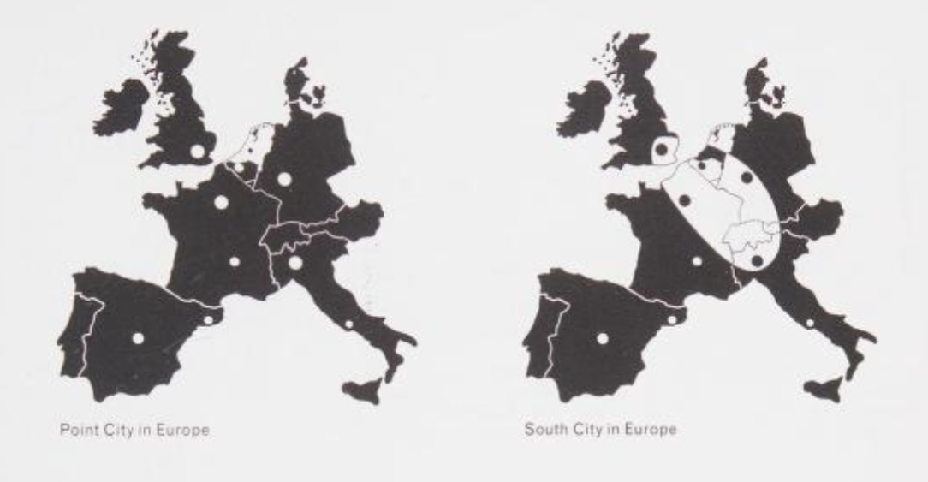

Slide 13
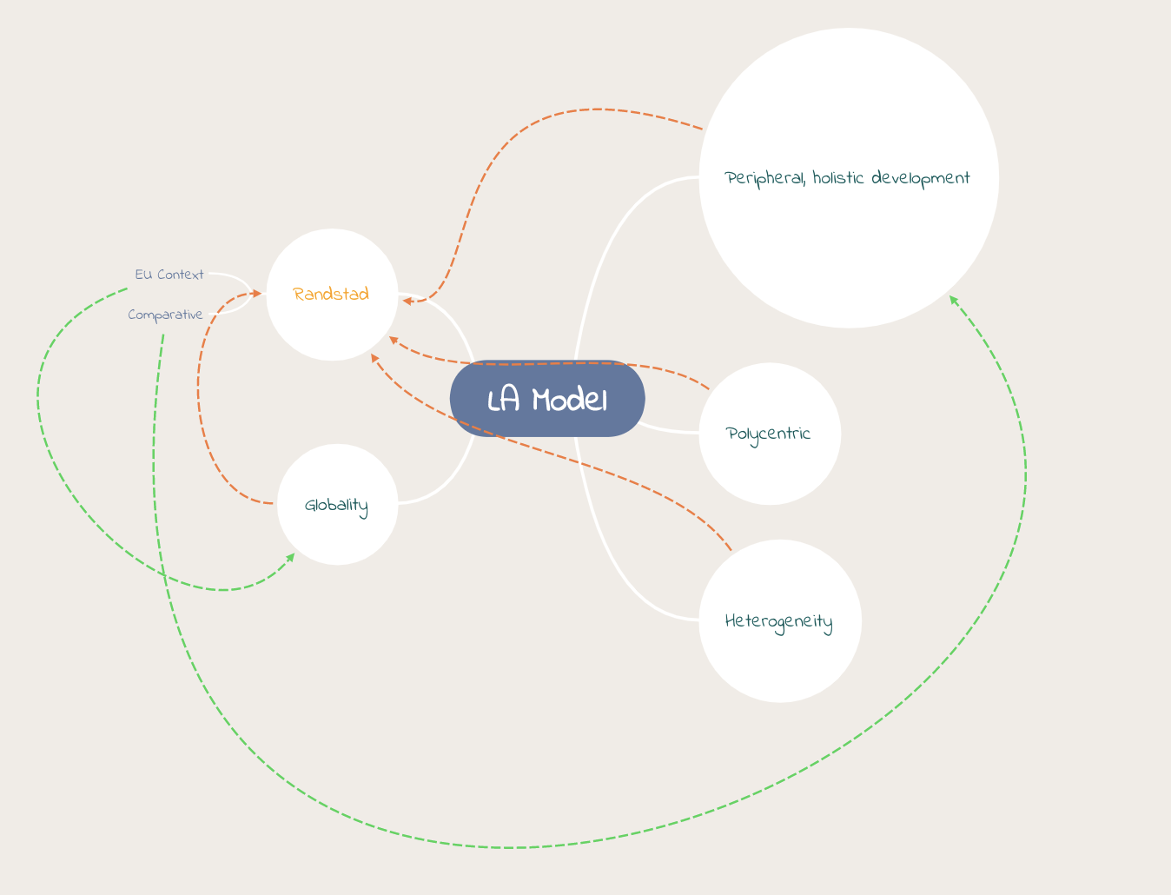
Plug-in
Mutate

Slide 15
References
Benton-Short, L., & Short, J. R. (2013). Cities and Nature. Routledge.
Dear, M. (2002). Los Angeles and the Chicago School: Invitation to a Debate. City and Community, 1(1), 5–32. https://doi.org/10.1111/1540-6040.00002
Gemeente Amsterdam. (2015). Policy: Circular economy. City of Amsterdam. https://www.amsterdam.nl/en/policy/sustainability/circular-economy/
Hillier, B. (2008). Space and spatiality: what the built environment needs from social theory. Building Research & Information, 36(3), 216–230. https://doi.org/10.1080/09613210801928073
Lambregts, B. (2006). Polycentrism: Boon or Barrier to Metropolitan Competitiveness? The Case of the Randstad Holland. Built Environment, 32(2), 114–123. https://doi.org/10.2148/benv.32.2.114
Manufacturing intellect. (2016, August 16). Rem Koolhaas interview (1994). Www.youtube.com. https://youtu.be/7lw-HV2Hk3g?si=OZUfU_UDIVDc6zE5. Rem Koolhaas talks about the architect/planner’s role in transforming a city and his new exhibit at the MoMA.
Rem Koolhaas, Mau, B., & Office For Metropolitan Architecture. (1998). S, M, L, Xl. Monacelli Press.
Soja, E. W. (1996). Thirdspace : Journeys to Los Angeles and Other Real-and-Imagined Places. Blackwell Publishers.
Soja, E. W. (2000). Postmetropolis : critical studies of cities and regions. Blackwell Publishers.
Tullis, P. (2023, November 16). Nitrogen wars: the Dutch farmers’ revolt that turned a nation upside-down. The Guardian. https://www.theguardian.com/environment/2023/nov/16/nitrogen-wars-the-dutch-farmers-revolt-that-turned-a-nation-upside-down
Vos, R. O. (2007). Defining sustainability: a conceptual orientation. Journal of Chemical Technology & Biotechnology, 82(4), 334–339. https://doi.org/10.1002/jctb.1675
Burke, G. L. (1966). Greenheart Metropolis: Planning the Western Netherlands (p. 184). Palgrave Macmillan .
Lambregts, B., & Zonneveld, W. (2004). From Randstad to Deltametropolis: changing attitudes towards the scattered metropolis1. European Planning Studies, 12(3), 299–321. https://doi.org/10.1080/0965431042000195056
van der Valk, A. (1991). Randstad-Green Heart Metropolis: Invention, Reception and Impact of a National Principle of Spatial Organization. Built Environment (1978-), 17(1), 23–33. https://www.jstor.org/stable/23286787
van der Valk, A., & Faludi, A. (1997). The Green Heart and the Dynamics of Doctrine. Netherlands Journal of Housing and the Built Environment, 12(1), 57–75. https://www.jstor.org/stable/41107681

Slide 16
Thank
You

